Slide 1

Insurance Application Process
Vladimir Budimirovic
Head of Business Development
Janic Istanto
Chief Information Officer
Boglarka Racz
Head of Communication and Automation
Module: Digitalisation of Business Processes
Student Project 2020
Presentation of 4 June 2020

Slide 2
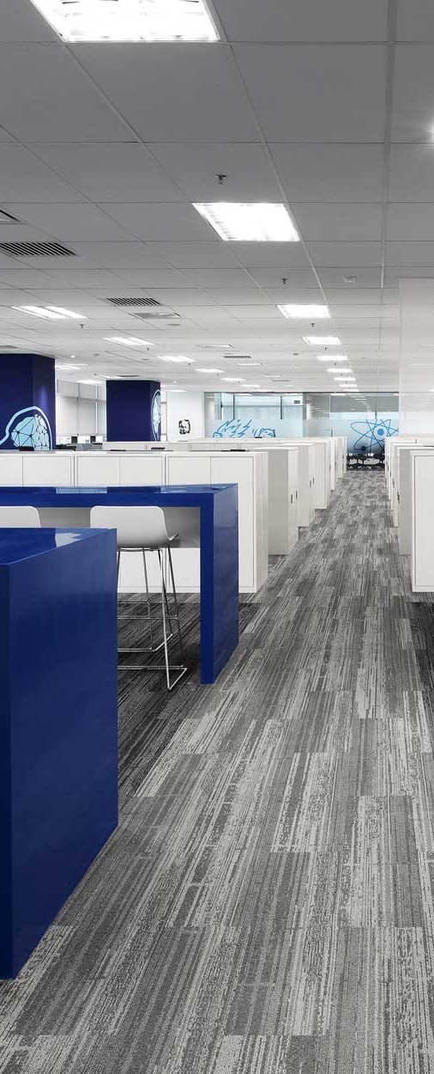
AGENDA
Introduction
Current situation
Solution approach
Demo
Conclusion
2

Slide 3
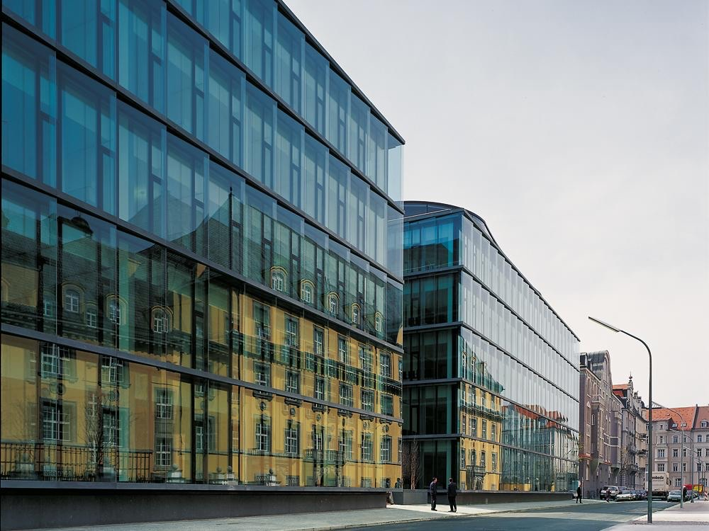
1. INTRODUCTION
Current situation, Challenges
3

Slide 4
Current Situation
DigiBP Versicherung AG faces profitability issues that endanger the company existence
The company has identified two major challenges:
Brand image perception
Internal process inefficiencies
The «Onboarding of a new customer» process will serve as a pilot to the company wide digital transformation
4

Slide 5


CHALLENGES
Paper-only application
Entirely manual decision making
Interaction with customers
5
Notes:
Some challanges for the specific processes

Slide 6
2. SOLUTION APPROACH
Goals & Improvements
6

Slide 7


OBJECTIVES
Entirely digitalise customer facing operations
Automatize the preliminary decision and premium pricing
Increase conversion rate
Increase the number of new clients by 30%
Decrease internal cost of onboarding by 50%
7

Slide 8



Improvements
Integration of
a ChatBot
Automated
process tasks
More efficient
process
8

Slide 9
3. DEMO
Video of the process
9

Slide 10
3. CONCLUSION
Conclusion, Used tools, Questions, References
10

Slide 11


CONCLUSION
Financial benefits
Better brand image
Increased customer satisfaction
Increased employee satisfaction
11

Slide 12

Used Tools
Camunda
Modeler
Google
Sheet
GitHub
Integromat
Postman
DialogFlow
Google
Form
Eledo PDF Creator
12

Slide 13


QUESTIONS
13

Slide 14
REFERENCES
Background images
https://www.ubi.com.tr/en/what-does-digital-transformation-mean-for-insurance/ (28-05-2020)
https://inspiration.detail.de/_uploads/5/a/c/5ac7866a8e142/DET-2006-10-2002-1266-Versicherungsgeba%CC%88ude-in-Mu%CC%88nchen-Baumschlager-Eberle-1.jpg (28-05-2020)
https://www.zurich.com/-/media/project/zurich/dotcom/about-us/images/our-global-working-environments/stage-kuala-lumpur.jpg?la=en (28-05-2020)
https://pxhere.com/en/photo/935385 (28-05-2020)
http://www.thierry-ball.de/newsroom/detail/news/das-ziel-ist-das-ziel-oder-doch-der-weg/ (28-05-2020)
https://pxhere.com/de/photo/993044 (28-05-2020)
https://monastery.me/2018/02/12/the-stairs-are-wide/ (28-05-2020)
https://mellowmove.com/en/mellowmove-surfcamp-portugal-home/holzwand-quer-3/#iLightbox[postimages]/0 (28-05-2020)
Tools
https://chrome.google.com/webstore/detail/bpmnio/hhikcjnalmkhinbomccdibaolelcpjli (02-06-2020)
https://www.getapp.de/software/116391/integromat (02-06-2020)
https://www.testautomatisierung.org/lexikon/postman-api/postman/ (02-06-2020)
https://github.com/logos (02-06-2020)
https://www.linkedin.com/company/dialogflow/?originalSubdomain=ch (02-06-2020)
https://it-antwort.de/2016/11/20/umfragen-erstellen-mit-google-forms/ (02-06-2020)
https://www.sisense.com/data-connectors/google-sheets/ (02-06-2020)
14

